Slide 1

SILENCE: Protecting privacy in offloaded speech understanding on resource-constrained devices
The 38th Annual Conference on Neural Information Processing Systems (NeurIPS 2024)
Dongqi Cai¹, Shangguang Wang¹, Zeling Zhang¹,
Felix Xiaozhu Lin², Mengwei Xu¹
¹ Beiyou Shenzhen Institute
² University of Virginia

Slide 2



Privacy concern for cloud speech service
Audio
Wimpy
Device
Raw Signal
Biometric, Sensitive entity,
Semantics, Transcript…
Intent
(a). Offloaded speech understanding on wimpy devices
Notes:
We are surrounded by ,
They can automatically help us complete some tasks, however, some privacy-preserving information

Slide 3
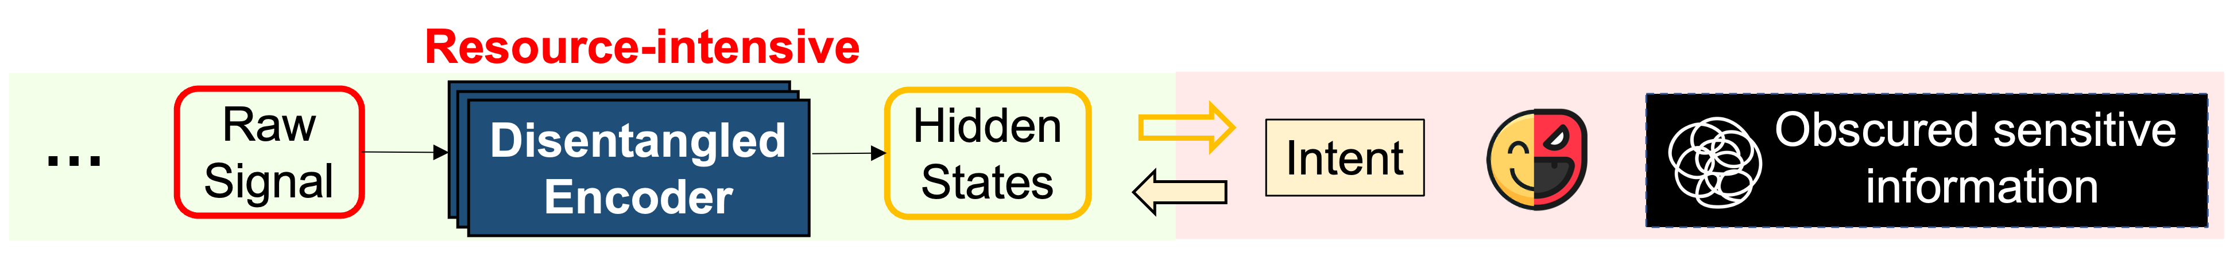
Privacy concern for cloud speech service
Audio
Wimpy
Device
Raw Signal
Biometric, Sensitive entity,
Semantics, Transcript…
Intent
(a). Offloaded speech understanding on wimpy devices
(b). Previous approaches to protect speech privacy
Notes:
So, some previous work levearage… to decouple
However, they are very resource-intensive because they need complex model design to succe…

Slide 4
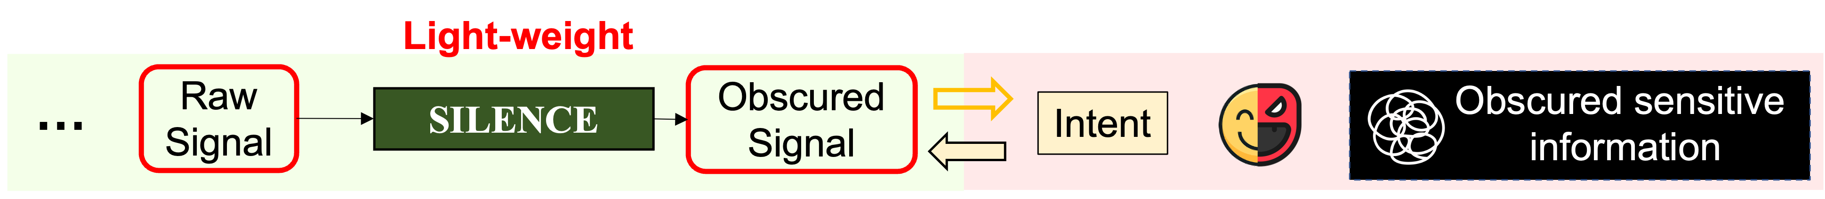
Privacy concern for cloud speech service
Audio
Wimpy
Device
Raw Signal
Biometric, Sensitive entity,
Semantics, Transcript…
Intent
(a). Offloaded speech understanding on wimpy devices
(b). Previous approaches to protect speech privacy
(c). Our SILENCE: a novel asymmetric dependency-based encoder
Notes:
In this work, we design a

Slide 5
Observation: Asymmetric dependency
Notes:
Each of our phoneme is short-dependent, is recognition is only relevant to a small portion of the waveform

Slide 6
Observation: Asymmetric dependency
Notes:
However, the speech intent, is long-dependent.
And the attention block is designed to extract

Slide 7
Observation: Asymmetric dependency
Notes:
We have some empirical experipents to demonstrate that more

Slide 8
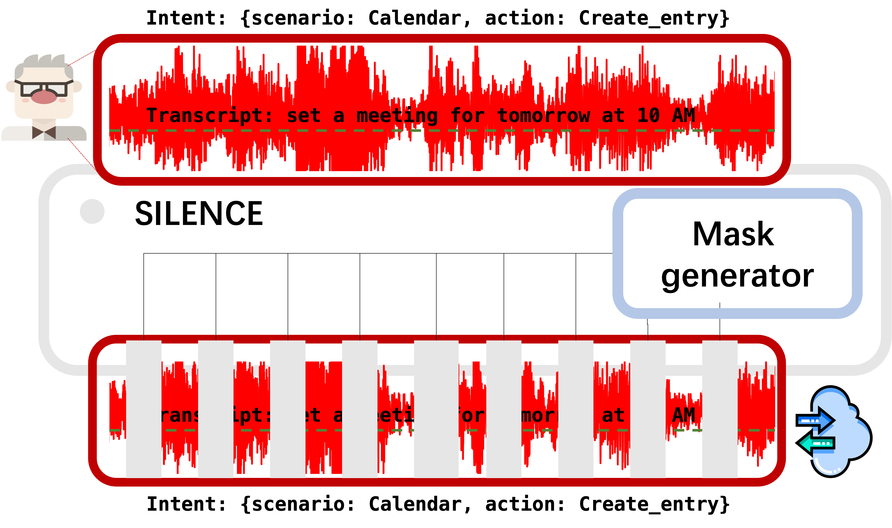
System overview
Notes:
Cut those short-dependent phoneme, while preserving those global-depent intent

Slide 9
Concrete design: interpretable mask
Notes:
More concretely, we
It was designed in two steps

Slide 10


Results: attack protection
As safe as entangled encoder, with good SLU performance.

Slide 11
Results: on-device efficiency
134.1x less memory, making it runnable on MCU!
With up to 53.3x speedup.

Slide 12
SILENCE: Protecting privacy in offloaded speech understanding on resource-constrained devices
The 38th Annual Conference on Neural Information Processing Systems (NeurIPS 2024)
Dongqi Cai¹, Shangguang Wang¹, Zeling Zhang¹,
Felix Xiaozhu Lin², Mengwei Xu¹
¹ Beiyou Shenzhen Institute
² University of Virginia

